Slide 1

Agentic AI Hackathon: Building Intelligent Agents with IBM Granite and LangFlow

Slide 2


Name of the team: Wannabe Interns
Details of Team members
TEAM MEMBER NAME | Recent Passport Photo | Email ID | Phone number [WhatsApp]
Hemanth R |  | hemanthr.cd23@bmsce.ac.in | 9741651222
Vedantha Vinay Vernekar |  | vedanthavinay.cd23@bmsce.ac.in | 9482115869

Slide 3
Problem statement
Traffic Flow Pattern Analysis
Traffic planning can be overwhelming, as urban planners and traffic authorities often struggle with:
Data fragmentation – Traffic data scattered across multiple sensors, GPS systems, and historical databases with no unified analysis platform.
Pattern recognition gaps – Inability to identify recurring congestion trends and their underlying causes across different times and locations.
Reactive management – Current systems respond to traffic issues after they occur, rather than understanding patterns proactively.
Manual analysis burden – Traffic engineers spend excessive time processing multi-source data to extract meaningful insights.
Anomaly blindness – Critical traffic incidents and unusual patterns go undetected until they cause significant congestion.
Without an intelligent pattern analysis system, traffic planners make decisions based on incomplete information, leading to ineffective congestion mitigation strategies, wasted infrastructure investments, and prolonged commute times affecting thousands of citizens daily.

Slide 4
Proposed solution
Traffic Pattern Detective - Intelligent Agentic Traffic Analysis System
Our solution employs a three-agent architecture orchestrated through LangFlow:
Agent 1: Pattern & Anomaly Detection Agent
Identifies recurring congestion patterns across different times and locations
Detects anomalies by comparing current traffic conditions with historical norms
Flags deviations >30% from baseline as significant events
Classifies anomaly severity (high, medium)
Agent 2: Insight & Recommendation Assistant
Powered by IBM Granite LLM via watsonx.ai
Analyzes detected patterns using RAG (traffic engineering principles, urban mobility research)
Generates human-readable insights explaining congestion causes
Provides assistive recommendations for traffic planners (not enforcement)
User Interface:
Interactive React dashboard where planners upload traffic data and receive visual analytics with AI-generated insights.

Slide 5
Need of project
Critical Urban Planning Need:
Scalability Crisis - Traditional manual analysis cannot keep pace with increasing urban traffic data volumes
Data-Driven Decision Making - Cities need evidence-based insights to optimize traffic infrastructure investments
Proactive Planning - Shift from reactive incident response to pattern-based congestion prevention
Resource Optimization - Help planners focus efforts on high-impact interventions identified by AI
Citizen Impact - Reduced congestion means less commute time, lower emissions, improved quality of life for urban populations
Market Gap:
Current traffic management systems focus on real-time monitoring but lack intelligent pattern analysis capabilities that learn from historical data to provide actionable planning insights.

Slide 6
End user of project
Municipal Traffic Departments
Traffic engineers analyzing congestion patterns
Urban planners designing road infrastructure
Transportation policy makers
Smart City Solution Providers
Companies building integrated urban mobility platforms
Traffic management system vendors
Urban analytics consultancies
Transportation Authorities
Metro/state highway departments
Public transit planning agencies
Traffic operations centers
Use Cases:
Weekly traffic pattern analysis for signal timing optimization
Infrastructure planning (where to build new roads/interchanges)
Event planning (managing traffic during festivals, sports events)
Policy impact assessment (evaluating traffic calming measures)
We are usihjhhhhg Age=ntic

Slide 7
Technology Used
Langflow platform
Langflow component name – Agent , Chat input, Chat output,
IBM Grainite model : ibm-granite-3-2-8b
IBM Cloud
IBM Watsonx.ai
Watsonx

Slide 8
Novelty and Uniqueness
First assistive-only traffic AI - Provides recommendations without enforcement, respecting human decision-making authority in urban planning
Multi-agent architecture - Unlike monolithic traffic systems, our three-agent design separates data aggregation, pattern detection, and insight generation for modularity and scalability
Baseline-driven anomaly detection - Compares real-time traffic against location-specific and time-specific baselines rather than generic thresholds
Granite-powered contextual insights - RAG integration ensures recommendations are grounded in traffic engineering best practices and urban mobility research
Hackathon-to-production ready - Built with enterprise IBM Cloud stack, deployable immediately for pilot city programs

Slide 9
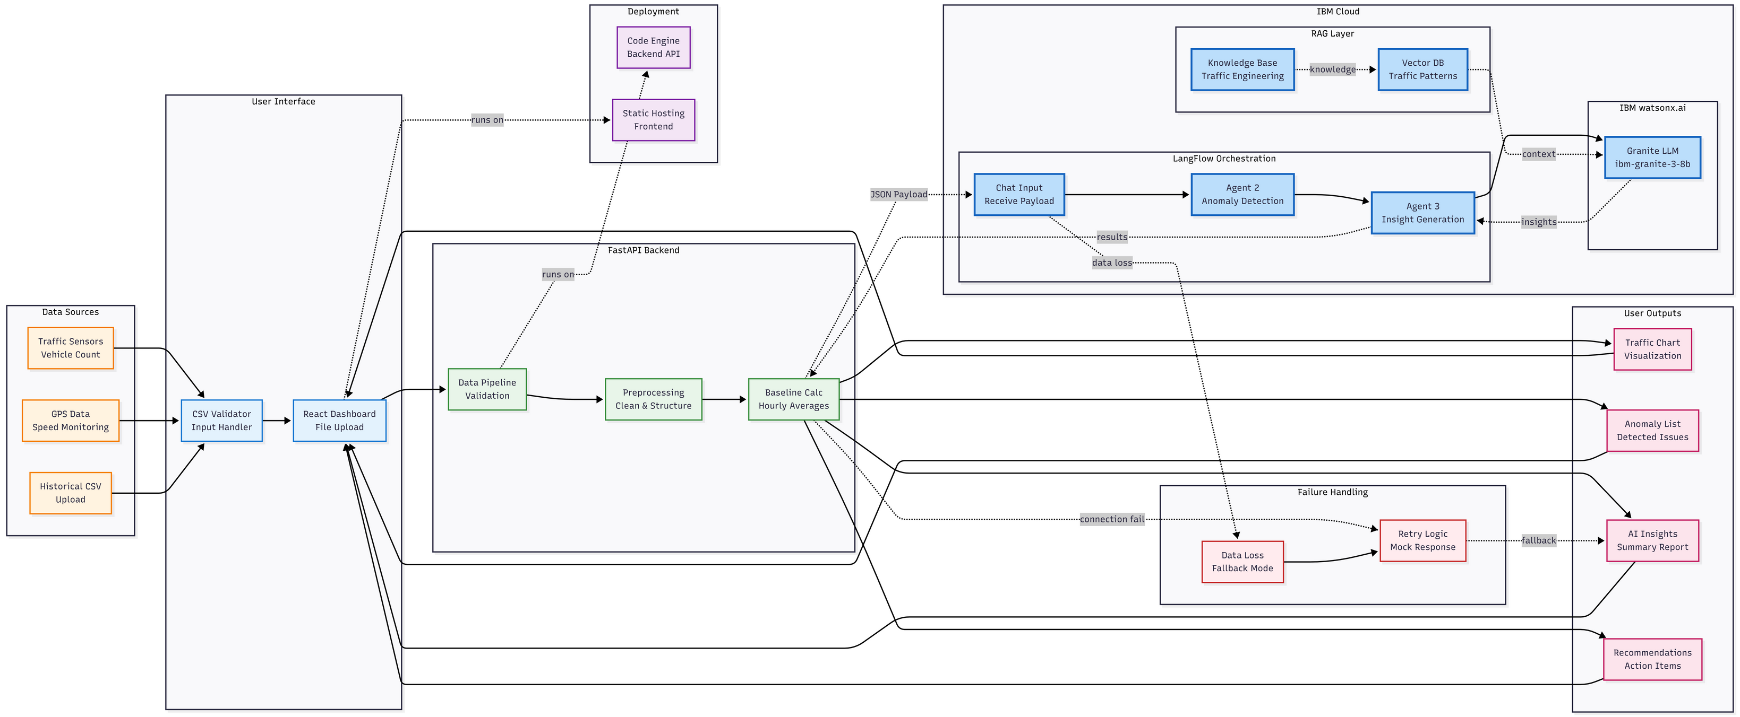
Technical flow diagram - Architecture blueprint

Slide 10
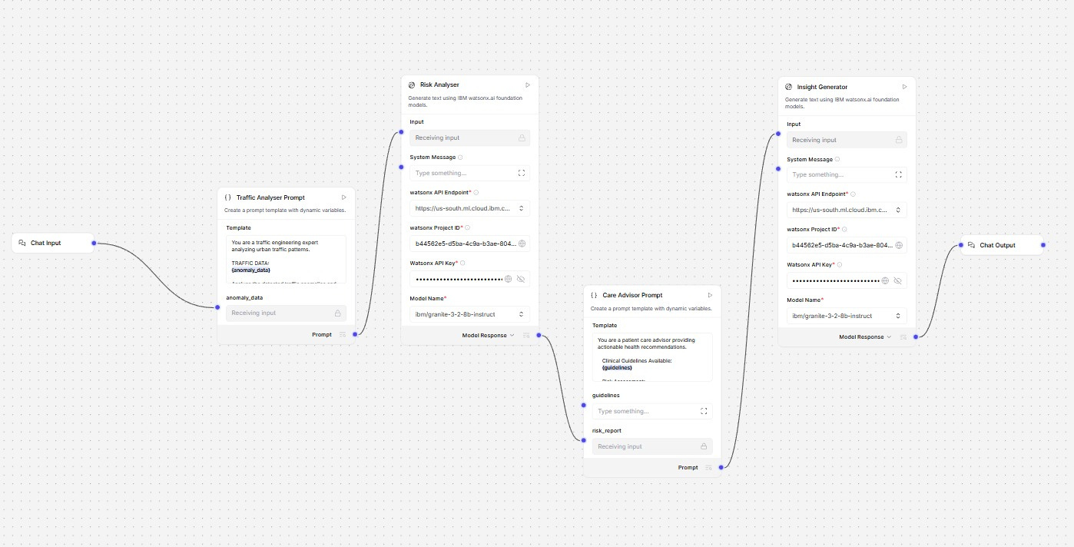
Langflow Design

Slide 11
Langflow component Used
1) Chat Input – CSV file content from Frontend
2) IBM watsonx AI Agent
3) File component: Uploading of CSV data files.
4) Watsonx Embedding Model
5) Chat output : Text output on Summary, Anomoly Detection, Recommendation on the processed data.
Fullstack Implementation:
FRONTEND:
1) File Upload: CSV file
2) Output: Chart Visualisation on Time Series Data
BACKEND:
1) Text parsing
2)Text preprocessing
3) Interacting with Langflow as Middleware
4) Text output on Summary, Anomoly Detection, Recommendation on the processed data

Slide 12
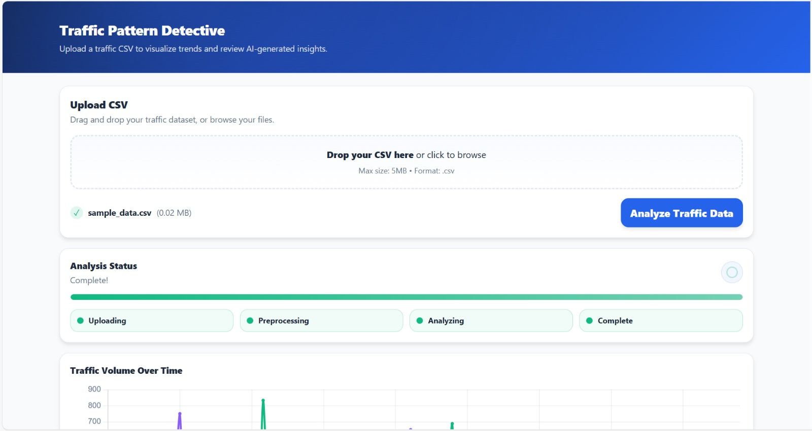

Slide 13
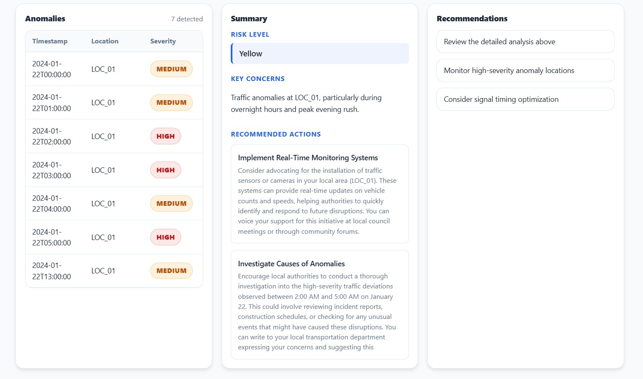

Slide 14
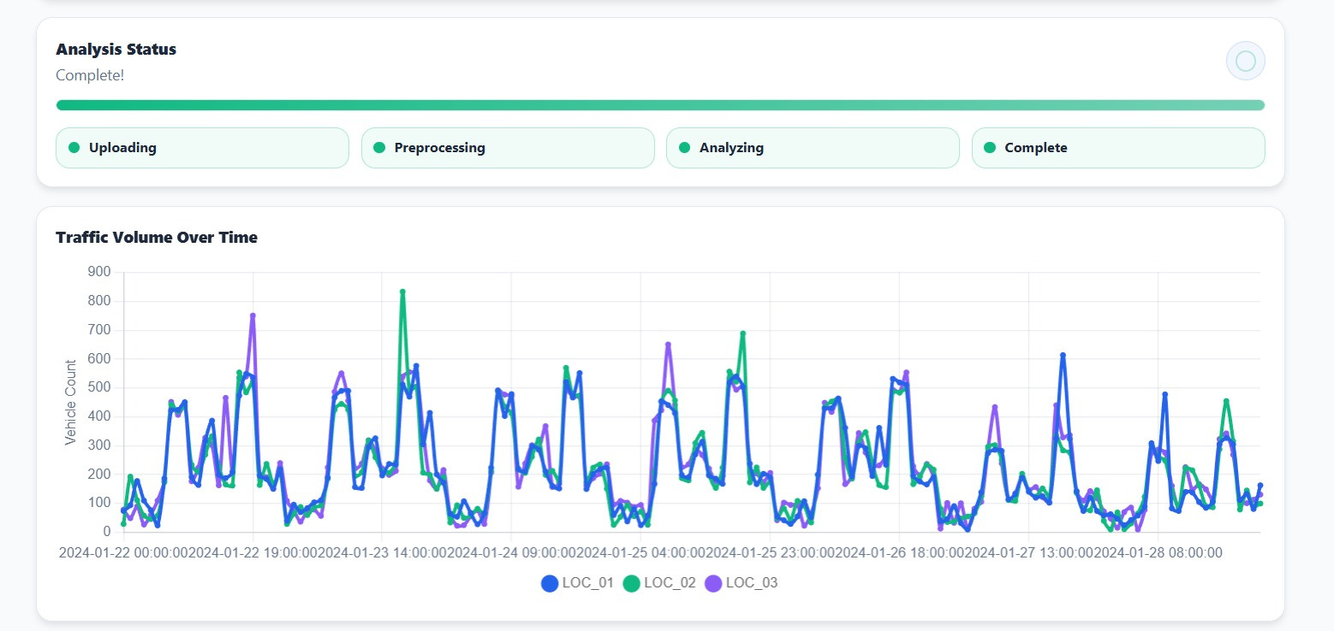

Slide 15
Future Scope
Real-time Sensor Integration - Connect directly to city traffic sensors for live analysis instead of CSV uploads.
Multi-city Comparison Dashboard - Enable planners to benchmark their city's traffic patterns against similar urban areas.
Mobile App for Field Teams - iOS/Android app for traffic engineers to access insights on-site during road inspections
Integration with Traffic Signal Systems - Provide API for adaptive signal timing systems (advisory recommendations only)
Weather Data Correlation - Incorporate IBM Weather Company data to correlate traffic anomalies with weather events
Public Transit Integration - Analyze how public transit schedules affect road congestion patterns.
·
·

Slide 16
GitHub Link
Repository Link:
https://github.com/Vedantha-V-V/traffic-pattern-analyser
Repository Contents:
/backend - FastAPI backend application
/frontend - React application folder
Problem-Statement.pdf - Problem statement document
Traffic-Pattern-Analysis.ppt - Project presentation
README.md - Setup instructions and project documentation
·

Slide 17
References
Technical Documentation:
IBM watsonx.ai Documentation - https://www.ibm.com/docs/en/watsonx/saas
LangFlow Documentation - https://docs.langflow.org/
IBM Granite Models - https://www.ibm.com/granite
Resources:
IBM Cloud - https://cloud.ibm.com
Langflow Cloud - https://datastax.com/langflow

Slide 18


